Slide 1

API Gateway Overview
The Modern Digital Entry Point: Mastering Architecture, Security, and Scalability in a Microservices Era

Slide 2


WHAT IS AN API?
The Digital Messenger
An Application Programming Interface (API) is the set of protocols and tools that allows different software applications to communicate seamlessly.
Connects disparate software components.
Standardizes data exchange formats.
Enables modular software design.

Slide 3



WHAT IS AN API GATEWAY?
The Traffic Controller
The Orchestrator
Acts as the single entry point for all client requests. It intercepts all incoming calls and routes them to the correct destination within a complex backend architecture.
Manages cross-cutting concerns like authentication, logging, and protocol translation, allowing backend microservices to focus exclusively on business logic.

Slide 4
Key Features & Architecture
The core capabilities that define a high-performance Gateway

Slide 5
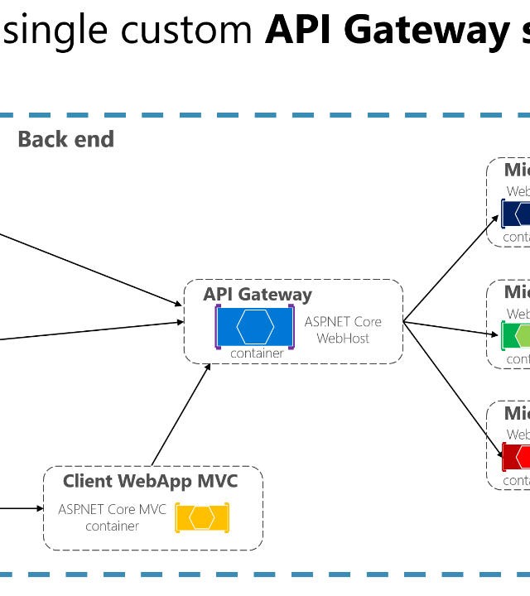
HOW IT WORKS
Request Reception: Client sends a request to the single Gateway endpoint.
Policy Enforcement: Gateway checks Auth, Rate Limits, and Whitelists.
Intelligent Routing: Dynamic routing to the appropriate microservice instance.
Response Aggregation: Combines data from multiple services into one payload.

Slide 6






TYPES OF API GATEWAYS
Cloud-Native
Self-Hosted
Microgateways
Managed services like AWS API Gateway or Azure APIM. Ideal for serverless and rapid scaling.
Open-source solutions like Kong or Tyk. Offers maximum control over infrastructure and privacy.
Lightweight proxies deployed close to individual services in a service mesh environment.

Slide 7



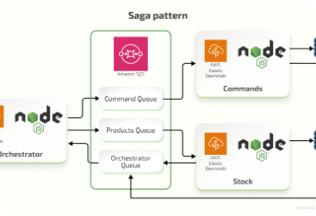


STRATEGIC USE CASES
Microservices
Modernization
Mobile Support
Decoupling client applications from internal service complexity.
Wrapping legacy SOAP or monolithic systems with modern REST/GraphQL APIs.
Reducing round-trips by aggregating data into single mobile-optimized calls.

Slide 8

SECURITY FEATURES
Authentication: Support for OAuth2, OIDC, JWT, and API Keys.
WAF Integration: Protection against SQLi, XSS, and common exploits.
SSL Termination: Centralized certificate management and encryption.
IP Control: Granular whitelisting and blacklisting of traffic.

Slide 9
THROTTLING & RATE LIMITING
Preserving System Integrity
Rate limiting ensures that no single client can monopolize system resources. By setting quotas on a per-second or per-minute basis, the Gateway prevents backend "noisy neighbor" effects and protects against DDoS attempts.
10k+
REQUESTS PER SECOND
Result: 99.99% Availability during traffic spikes.

Slide 10
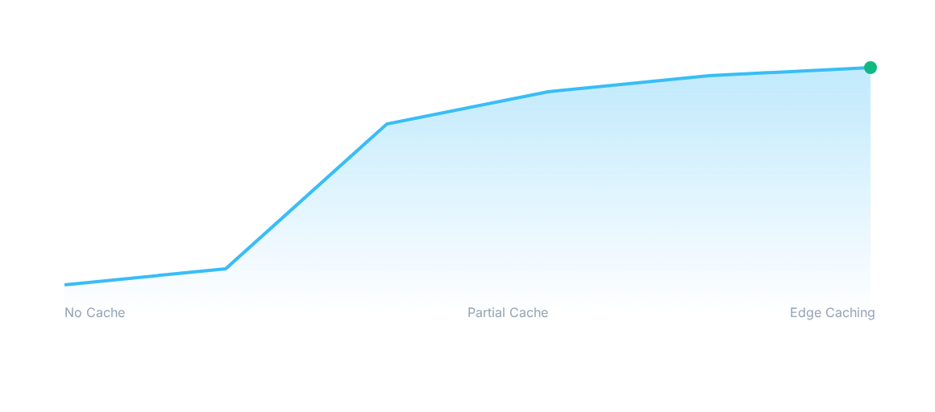
CACHING & MONITORING
Impact of Edge Caching on Latency (ms)
By caching frequent requests at the Gateway layer, response times drop from ~300ms to <30ms.

